Slide 1
Chapter 4: Threads

Slide 2

Single and Multithreaded Processes

Slide 3
Benefits
Responsiveness
Resource Sharing
Economy
Utilization of MP Architectures

Slide 4
Multithreading Models
Many-to-One
One-to-One
Many-to-Many

Slide 5
Many-to-One
Many user-level threads mapped to single kernel thread
Examples:
  Solaris Green Threads
  GNU Portable Threads

Slide 6

Many-to-One Model

Slide 7
One-to-One
Each user-level thread maps to kernel thread
Examples
  Windows NT/XP/2000
  Linux
  Solaris 9 and later

Slide 8

One-to-one Model

Slide 9
Many-to-Many Model
Allows many user level threads to be mapped to many kernel threads
Allows the operating system to create a sufficient number of kernel threads
Solaris prior to version 9
Windows NT/2000 with the ThreadFiber package

Slide 10

Many-to-Many Model

Slide 11
Java Threads
Java threads are managed by the JVM
Java threads may be created by:
  Extending Thread class
  Implementing the Runnable interface

Slide 12
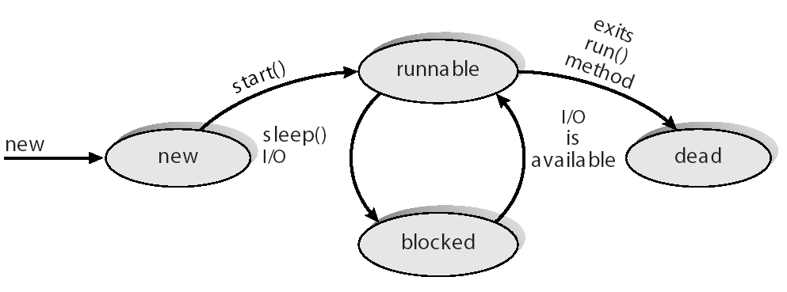
Java Thread States

Slide 13
End of Chapter 4

